Slide 1
London
Выполнила Остапущенко К. А.
Учитель английского языка
МСОШ № 3 п. Магдагачи

Slide 2
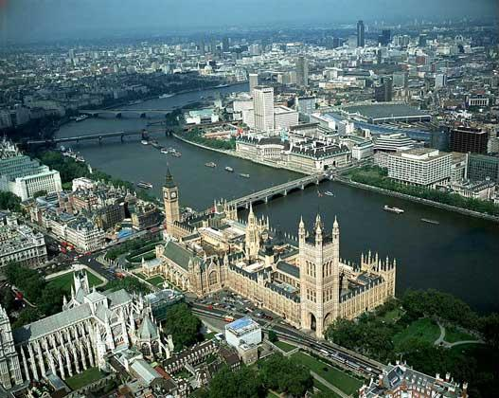
London
London is the capital of Great Britain, is political, economic and cultural centre. London is an ancient city. It is more than twenty cents old. The population of London, including its suburbs, is more than 9 million people. London is one of the biggest cities in the world and the largest city in Europe. It is situated on the banks of the River Thames.

Slide 3
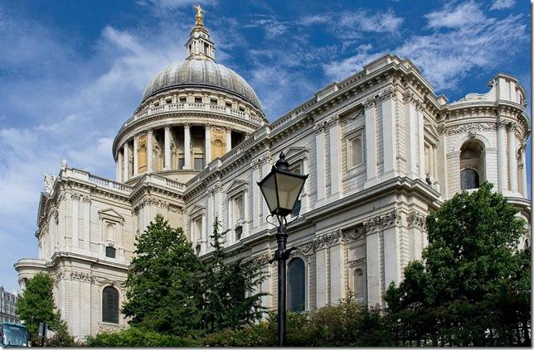
The City is the financial and the business centre of the country. There are a lot of banks and various offices here. It is the ancient part of London. One of the greatest English churches – St Paul’s Cathedral – is here. It was designed and built by an outstanding English architect Christopher Wren in 1710. St Paul’s Cathedral is the second large church in Europe. Admiral Nelson is buried there.

Slide 4
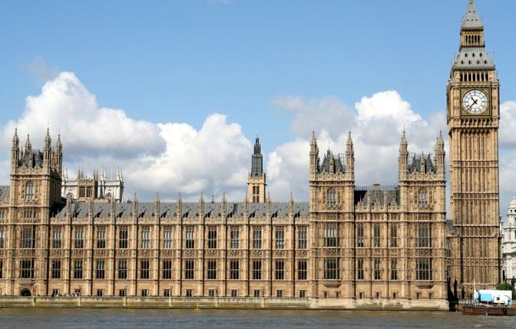
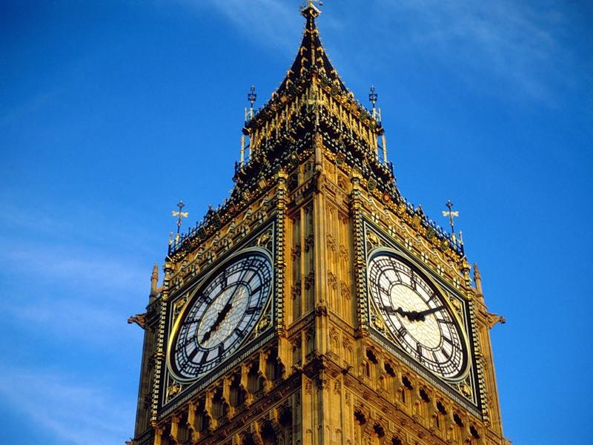
Not far away is Westminster – the administrative centre of London. The Houses of Parliament are situated here. It is the seat of the British Government. The building is very beautiful with its two towers and a big clock called Big Ben.

Slide 5
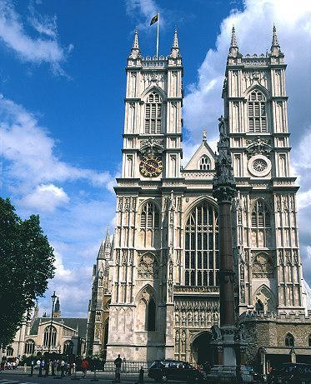
Westminster Abbey where kings and queens are crowned is opposite the Houses of Parliament. This ancient building was founded in the eleventh century. It was destroyed and rebuilt several times. Many famous people are buried here, among them Newton, Darwin, Dickens and Kipling.

Slide 6
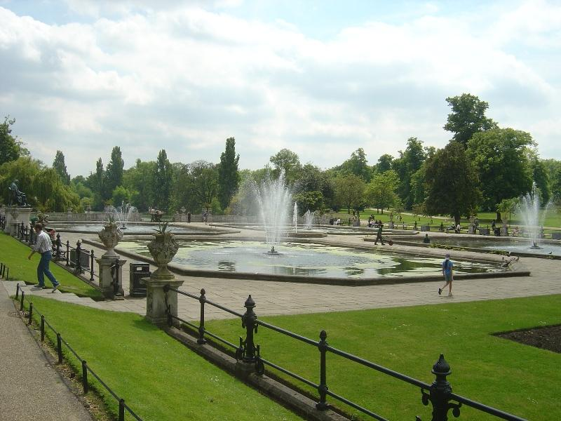
The West End is the part of London where rich people live. Fine houses, wide streets, numerous parks of the capital. The best cinemas, theatres, concert halls, famous shops, comfortable hotels, restaurants, large museums are situated here. The most beautiful London park – Hyde Park – is in this district too.

Slide 7
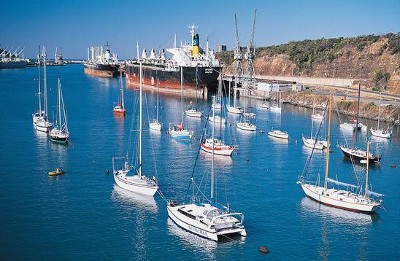
The East End includes the port, the docks stretching for miles and the great industrial areas, which depend on shipping.

Slide 8
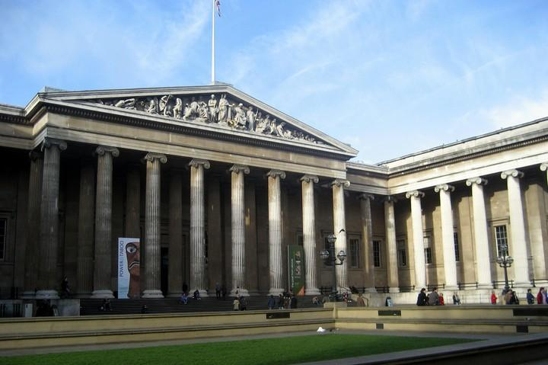
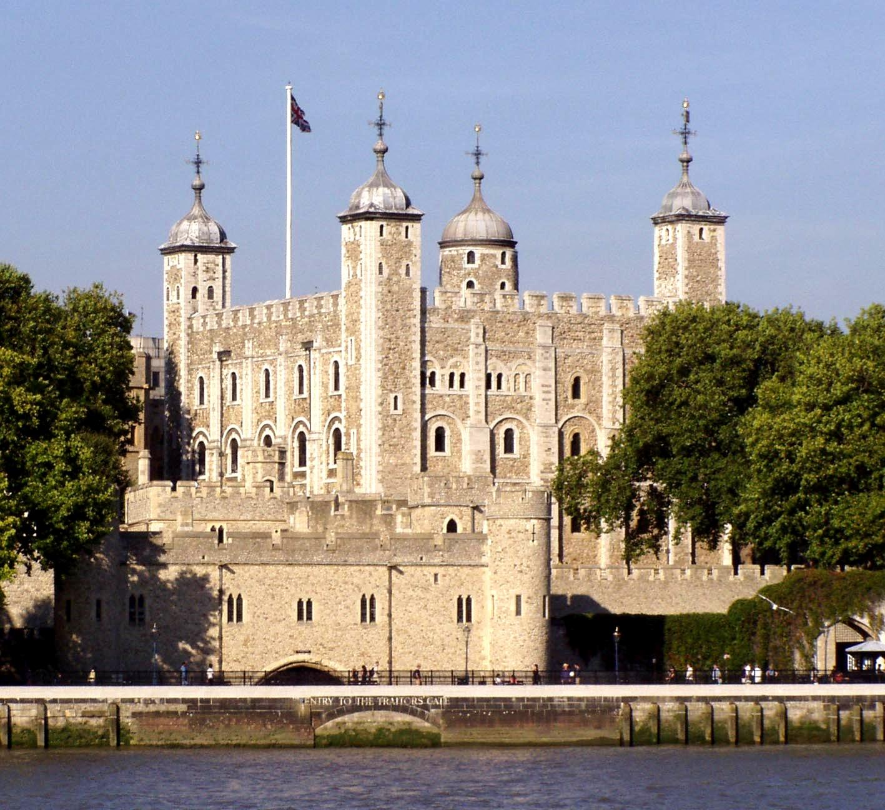
London is famous for its outstanding places of interest. There are many architectural, art and historic monuments in London such as the British Museum, the Tower of London, the National Gallery, Buckingham Palace, the Nelson Column and many others.
the British Museum
the Tower of London

Slide 9
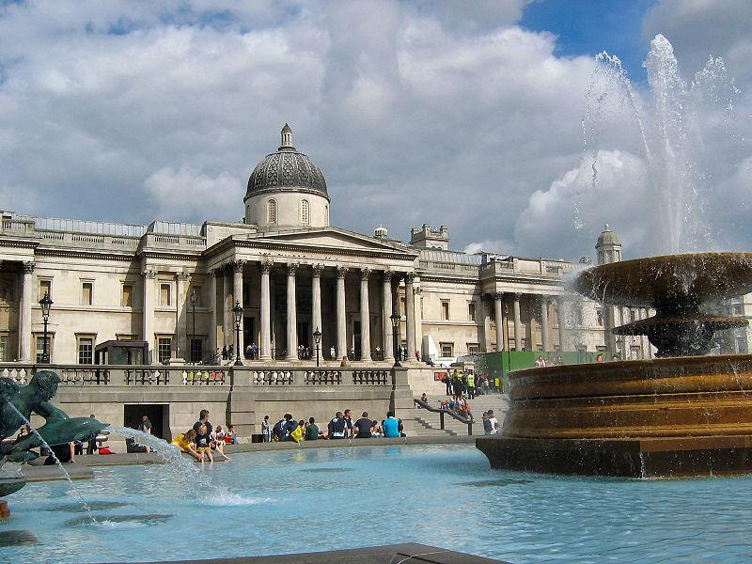
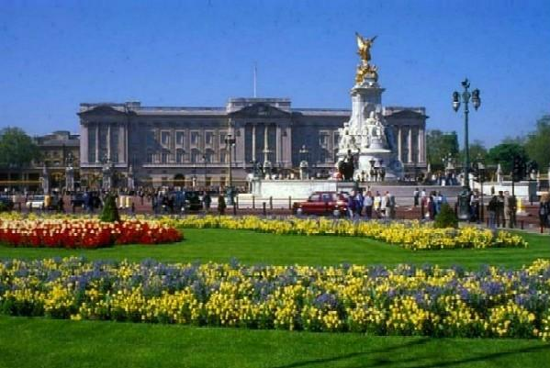
Buckingham Palace
the National Gallery

Slide 10
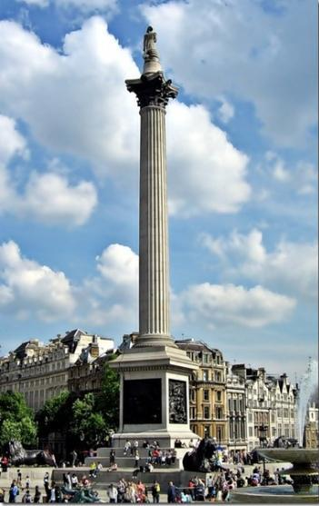
the Nelson Column

Slide 11
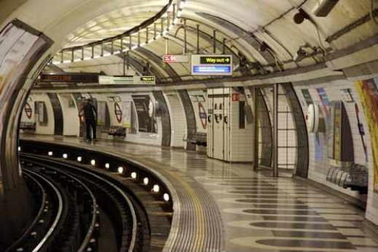
The London Underground is the oldest one in the world. It was opened in London in 1863.

